Slide 1


Dynamic Spallation of Film/Substrate Interfaces Tailored with Self-Assembled Monolayers:
A Multiscale Model on Interface Roughness Effect
Chen Zhang, Graduate Student
Aerospace Engineering
Jaeuk Sung, Graduate Student
Materials Science and Engineering
Philippe H. Geubelle, Professor
Aerospace Engineering
Nancy R. Sottos, Professor
Materials Science and Engineering
University of Illinois at Urbana-Champaign, USA

Slide 2
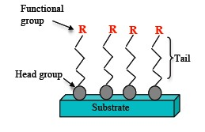
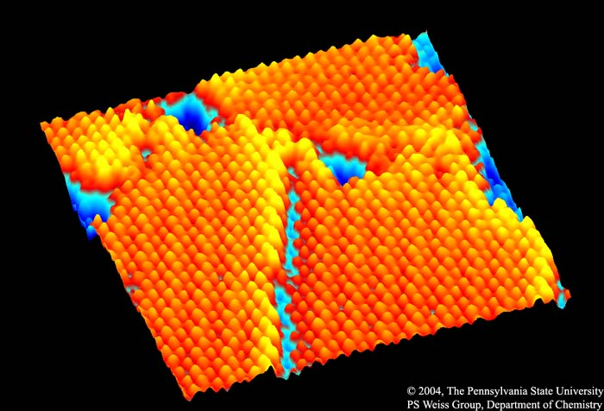
Self-Assembled Monolayers
Ordered molecular assemblies formed spontaneously on surfaces by adsorption
Each unit comprises of the ‘head group’, ‘tail’ and ‘functional group’
Monolayer kept intact by Van der Waals interactions
Applications
Wetting and adhesion
Chemical resistance
Nano-fabrication
For studying membrane properties of cells
Commercial application example: Rain-X
Bio-compatibility
Thermal management of nano-electronics
Surface modifiers of MEMS and NEMS
~ 1 nm
SURFACE
MODIFIERS
INTERFACE
TAILORING
Scanning tunneling microscope image (15 nm x 15 nm) of a SAM of n-decanethiolate on Au{111} (Paul Weiss’ group, PSU)

Slide 3
Materials
Self-assembling molecules (Gelest inc.)
Chemical | Formula | Shorthand Name
Dodecyltriethoxysilane | CH₃(CH₂)₁₁Si(OC₂H₅)₃ | DTES
11-mercapto-undecyltrimethoxysilane | SH(CH₂)₁₁Si(OC₂H₅)₃ | MUTMS
11-bromo-trimethoxysilane | Br(CH₂)₁₁Si(OC₂H₅)₃ | BrUTMS
11-amino-trimethoxysilane | NH₂(CH₂)₁₁Si(OC₂H₅)₃ | ATES
CH₃
SH
Br
NH₂
Mixed Monolayers
50% mole percent in solution
SiO₂ Substrate
Notes:
Also describe mixed monolayers here as well

Slide 4
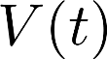
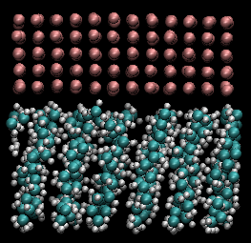
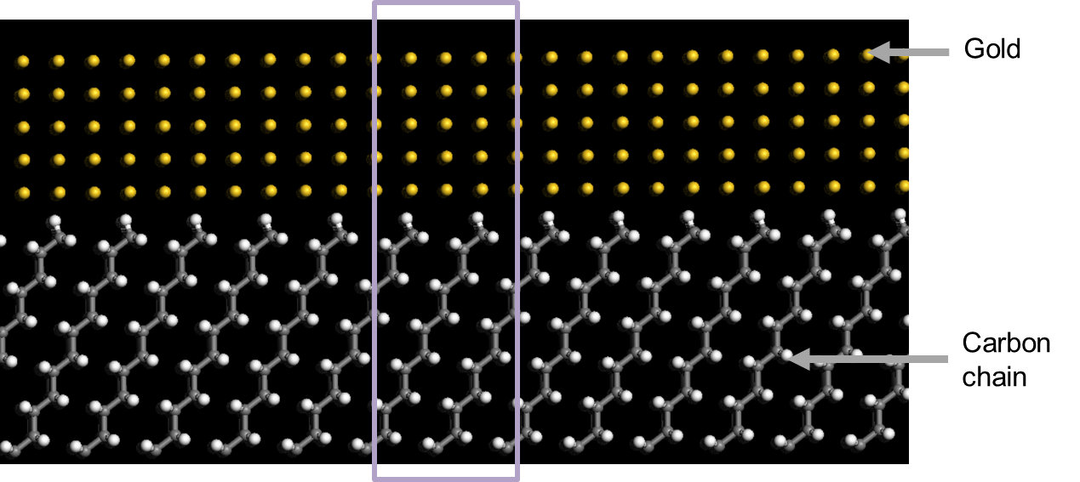
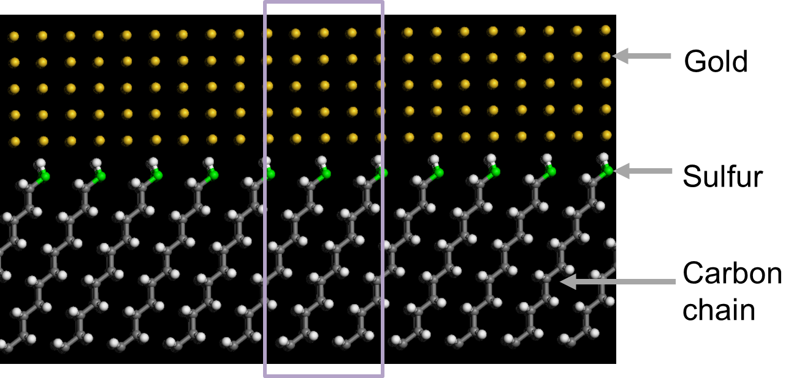
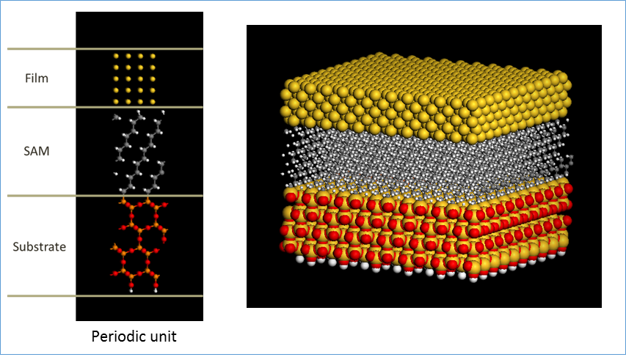
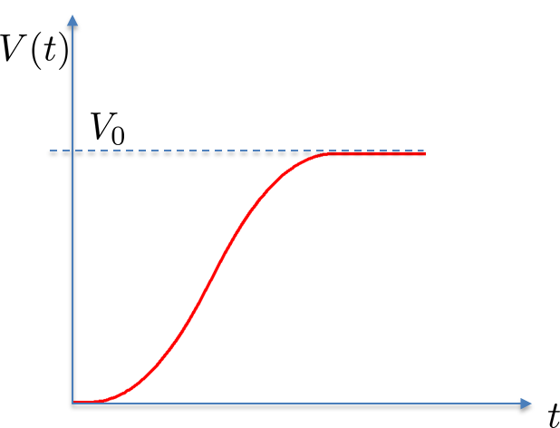
Molecular Dynamics Simulations
Silica/SAM/Gold model built using Materials Studio
In-plane periodic unit cell of size 25A x 25A x 40A (Contains about 1500 atoms)
Captures SAM tilt with respect to Silica layer
Thermal equilibrium (at 300K) and spallation simulations performed using LAMMPS
MD analysis based on ReaxFF potential to model bond failure (Jarvi et al., J. Phys. Chem. A, 2011)
“Smooth” application of constant velocity along top Au atomic layers
Dodecyltriethoxysilane | CH₃(CH₂)₁₁Si(OC₂H₅)₃ | DTES
11-mercapto-undecyltrimethoxysilane | SH(CH₂)₁₁Si(OC₂H₅)₃ | MUTMS
Velocity imposed on gold layer
Awasthi et al. Mech. of Mater., 2016

Slide 5
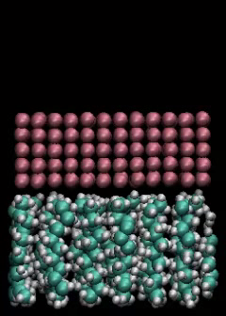
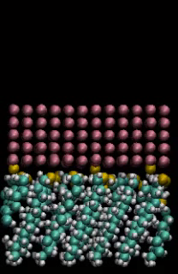
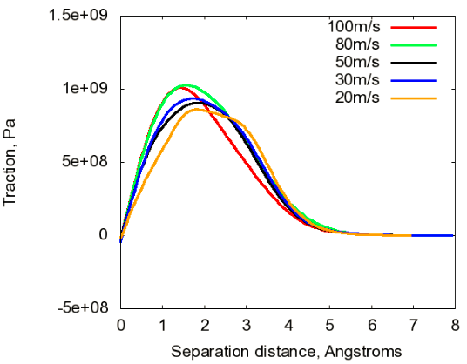
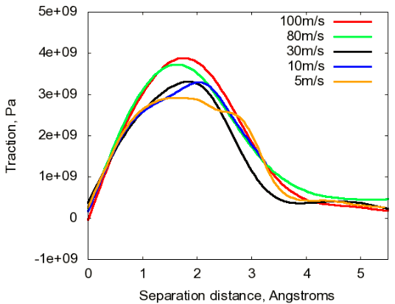
MD Predicted Cohesive Law
DTES
MUTMS
T=300K, V₀=30m/s
Work of separation ~ 0.3 J/m²
Interfacial strength ~ 0.75 GPa
Work of separation ~ 0.6 J/m²
Interfacial strength ~ 3 GPa
Awasthi et al., 2016

Slide 6
SAM Functionalization Procedure
SAM bath
24 hours
SAM molecule, amine catalyst, toluene
Rinse Toluene, Ethanol,
DI water,
blown dry
Piranha Solution
Clean
Transfer Printing
“Soft” lithography process
Material Characterization
Technique
Information Acquired
Ellipsometry
SAM layer thickness ~ 1 nm
Atomic Force Microscopy (AFM)
Surface topography, surface roughness
X-ray Photoelectron Spectroscopy (XPS)
Chemical information

Slide 7
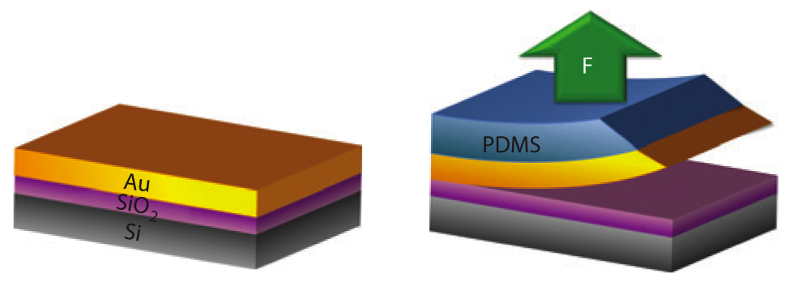
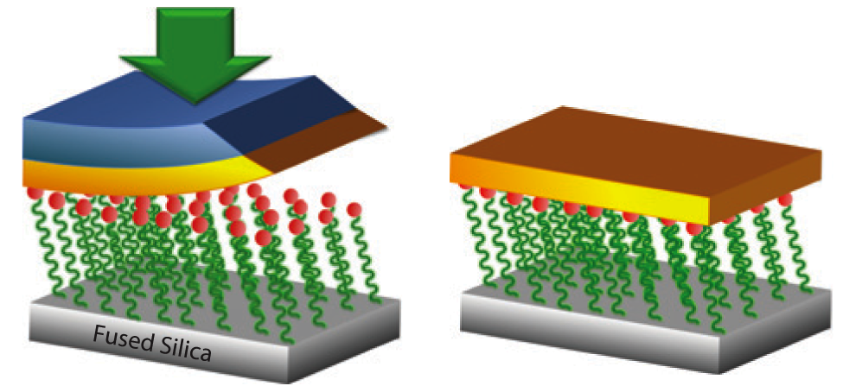
Transfer Printing Method
1
Deposit Au on donor substrate
2
Use PDMS stamp to peel off gold
3
Transfer Print to New Substrate
4
Peel off PDMS
SiO₂/SAM/Au
Losego et al. Nat. Mater., 2012

Slide 8
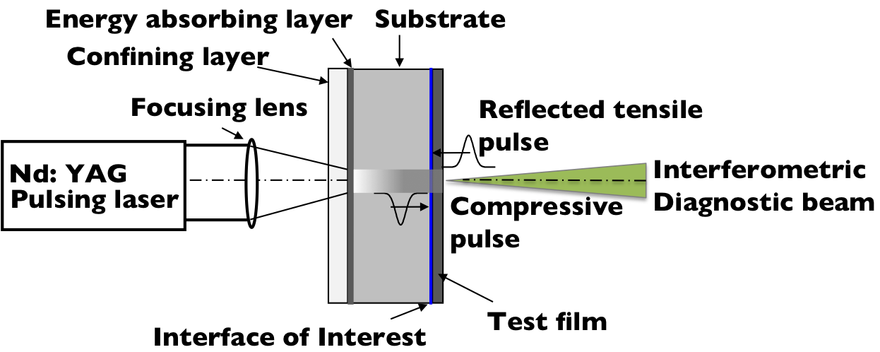
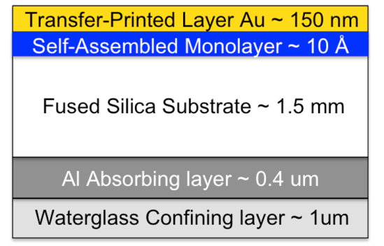
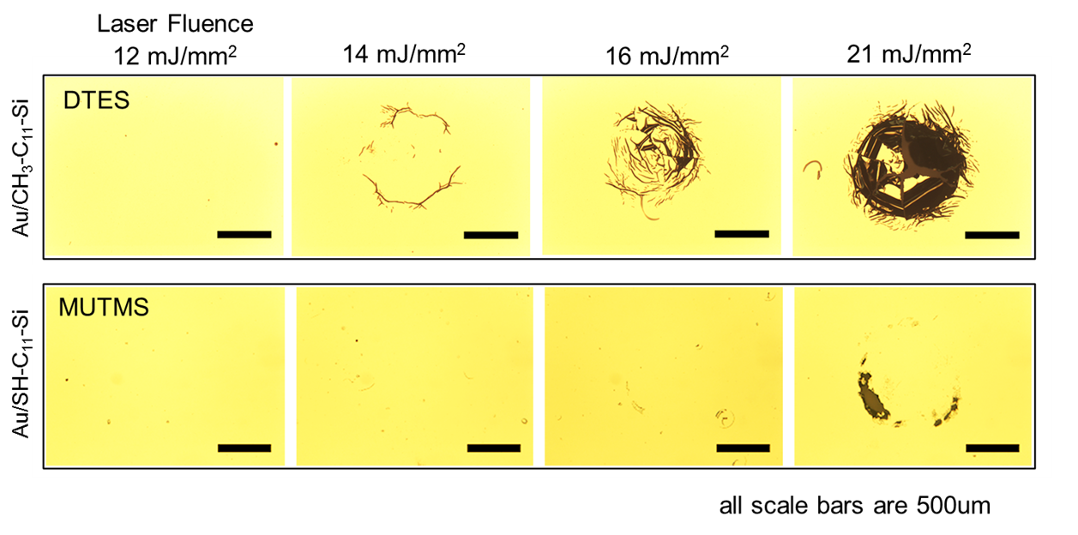
Interfacial Strength Measurement
Laser Spallation Technique
Specimen Schematic
Developed by: Vossen (1976), Gupta (1992)
Wang, Weaver & Sottos (2002)
12 mJ/mm²
14 mJ/mm²
16 mJ/mm²
21 mJ/mm²
Notes:
The laser-induced ablation of the confined Al absorbing layer results in the generation of a high amplitude compressive acoustic pulse, with a rise time comparable to that of the impinging light pulse. Upon reaching the free surface of the test film, the compressive pulse reflects back as a tensile pulse and loads the interface of interest in tension. If the magnitude of this tensile stress pulse is greater than the interfacial adhesion strength, the test film spalls from the substrate. 234 nm. 16.5 ns
yttrium aluminum garnet

Slide 9
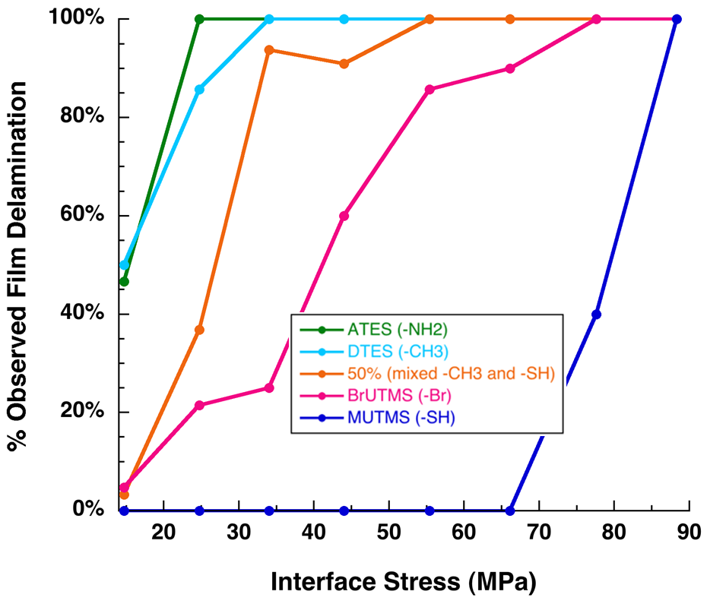
Experiments Predicted Interfacial Strength
Interface strength determined at interface stress that initiates film failure in >85% tests
Interfacial Strength
Experimental | Numerical (MD)
25 MPa | 0.75 GPa
85 MPa | 3 GPa
DTES
MUTMS
Good: MUTMS/DTES strength ratio similar
Bad: Off by a factor of 30…50
Grady et al., 2015

Slide 10
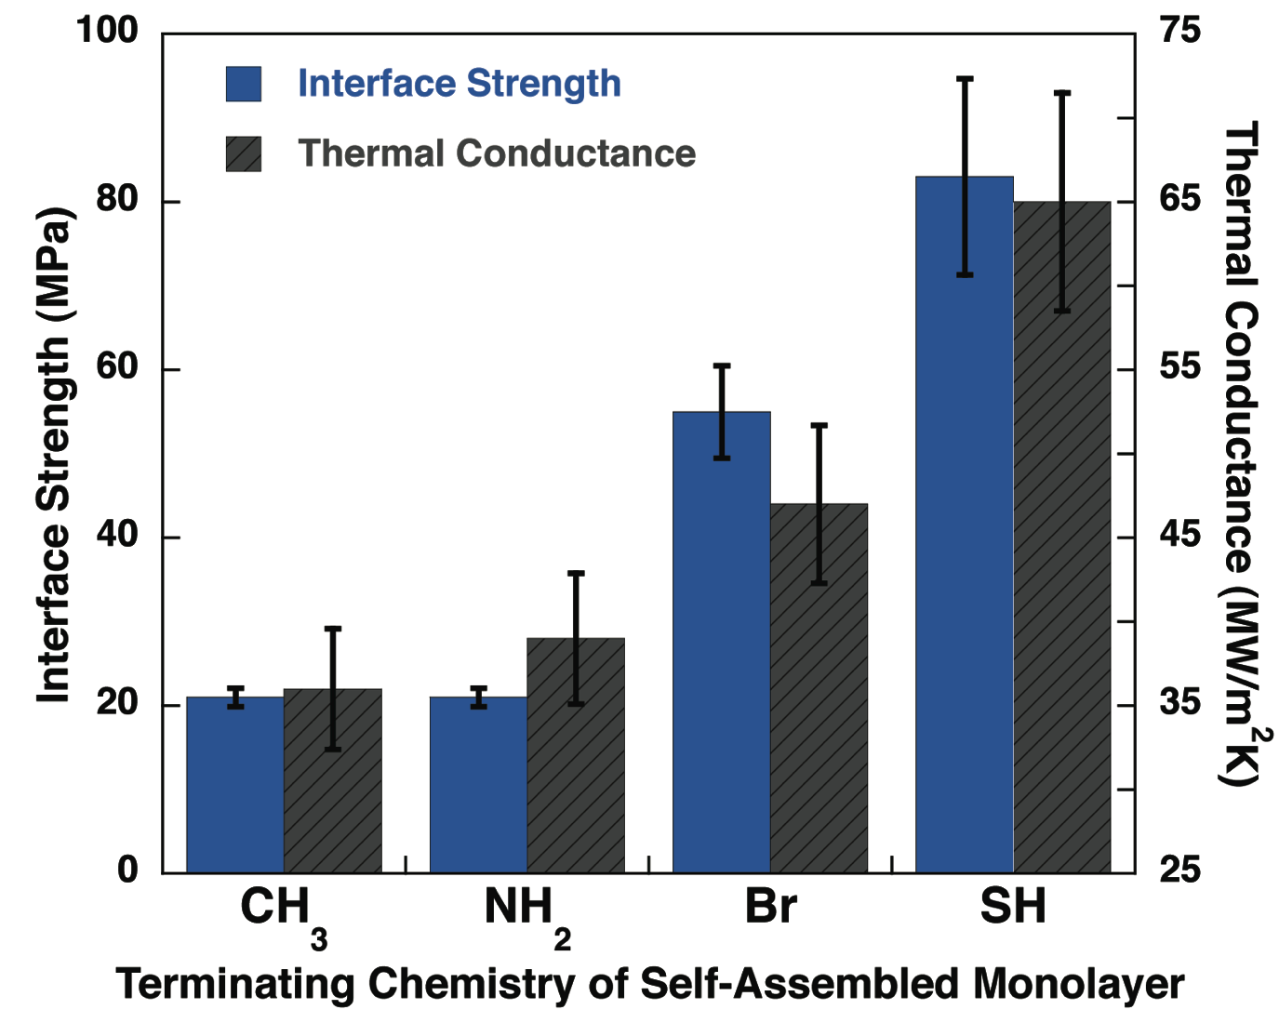
“Side note”: Interface Strength vs. Heat Transport
**
Strong correlation with thermal conductance
Effectively tune both properties with single monolayer
** Error estimated at ±5% TDTR Measurements (Losego et al., Nature Materials, 11, 502-506, 2012)
Notes:
----- Meeting Notes (9/26/13 16:41) -----
Discrete bars for the thermal plot

Slide 11
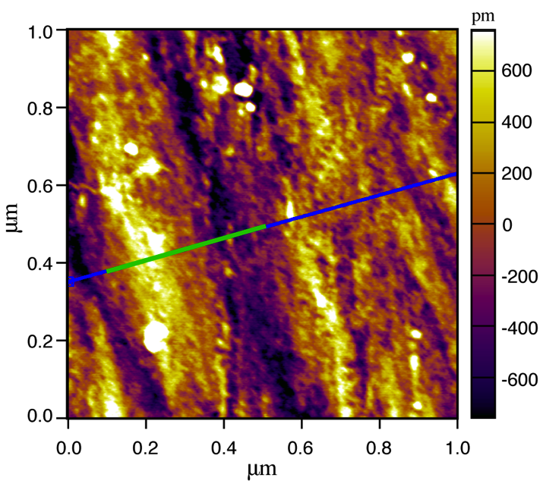
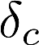
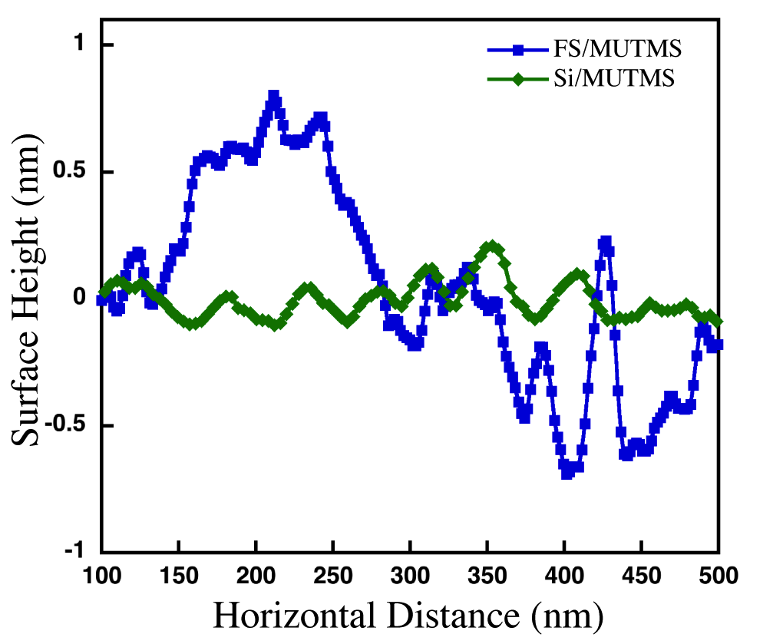
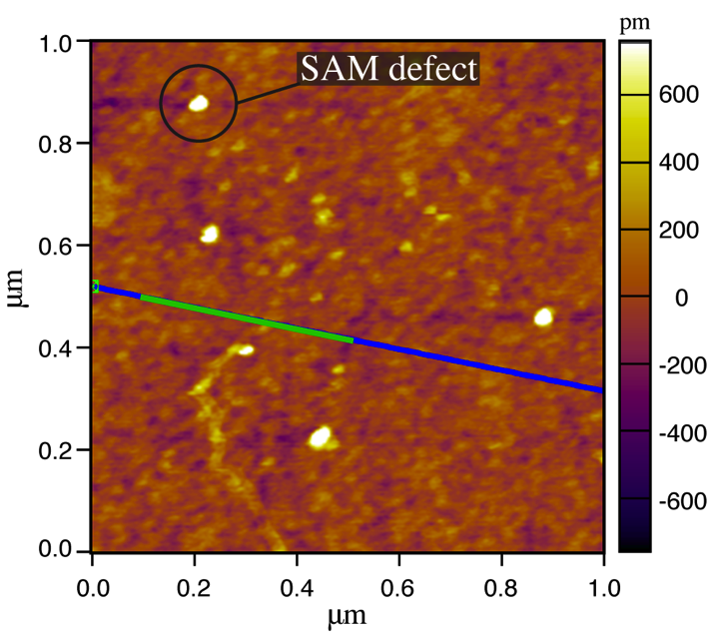
Surface Roughness: Si vs. Fused Silica
Recall:
Cohesive length scale ~ 0.2 nm
SAM layer thickness ~ 1 nm
AFM Scans
FS/MUTMS
Measured spallation strength
Si: ~ 200 MPa
FS: ~ 85 MPa
Si/MUTMS

Slide 12
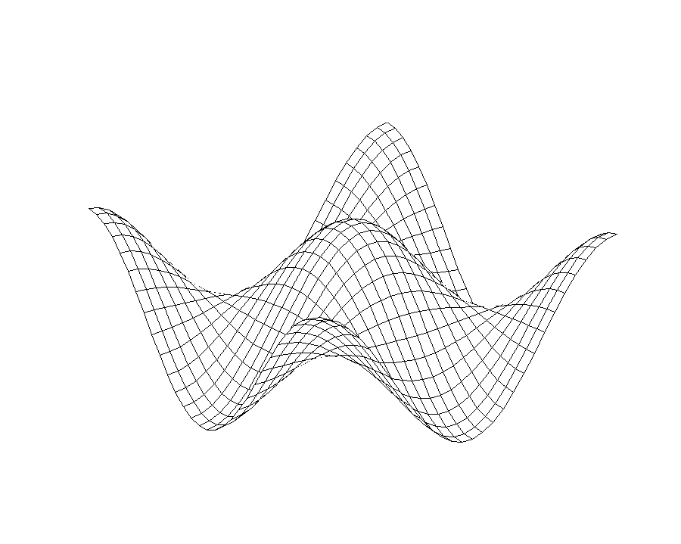
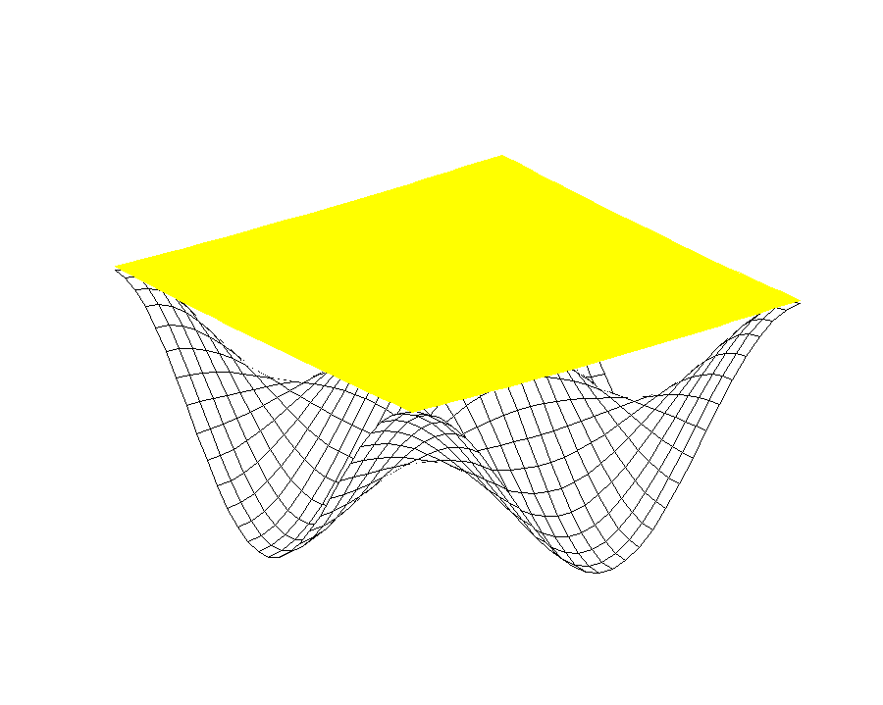
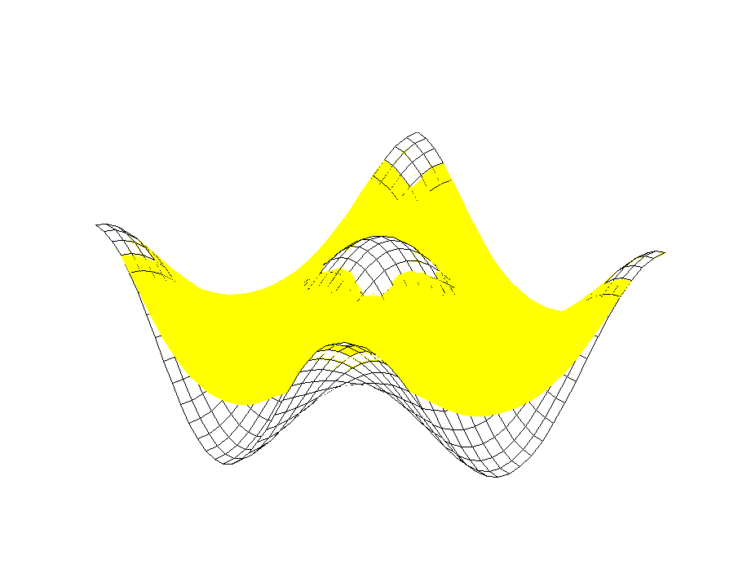
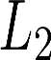

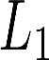
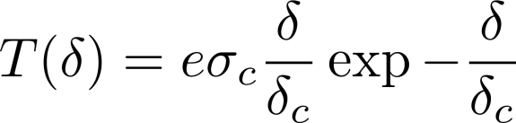
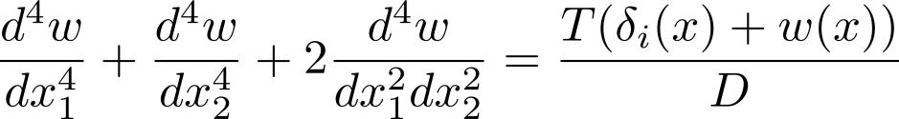
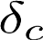

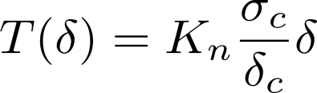

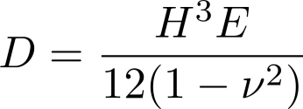
Effect of Surface Roughness: Continuum Model
Contact Region
From MD Simulations
T
Governing Differential Equation
with
Periodic BC
Notes:
12

Slide 13
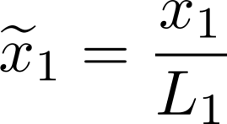
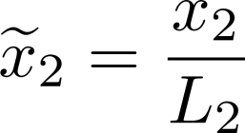
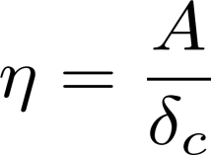
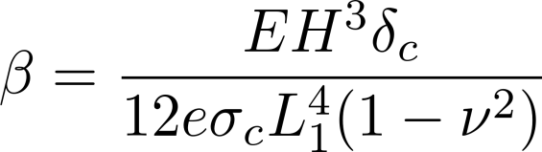
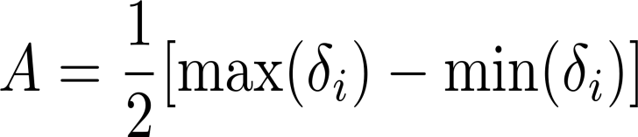
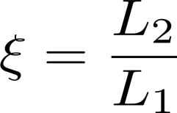
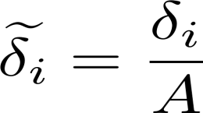
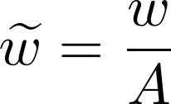
Non-Dimensional Equations
Typical thin film substrate system
Notes:
13

Slide 14
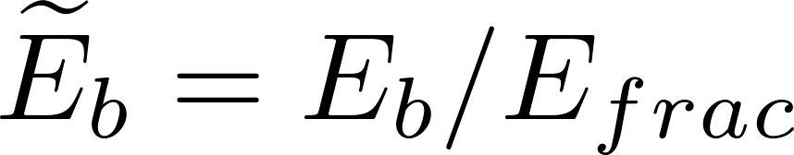
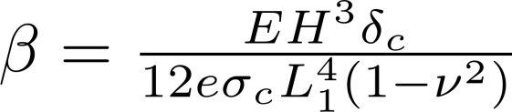
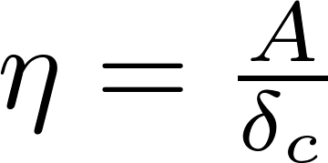
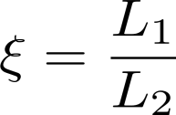
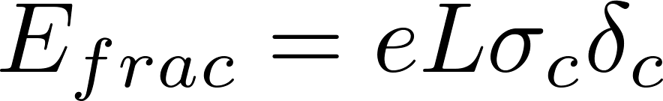
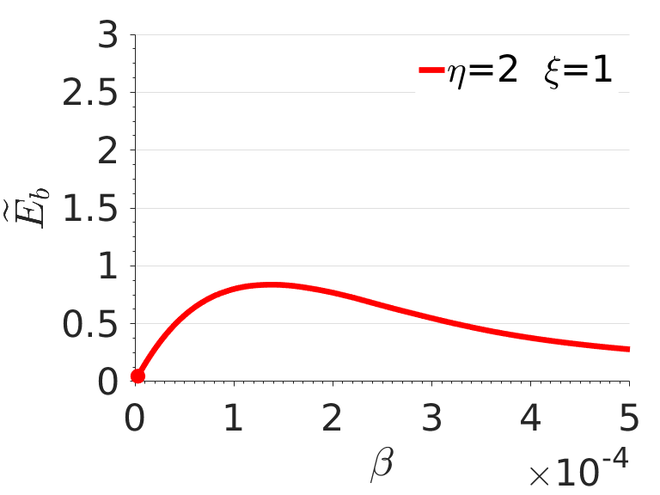
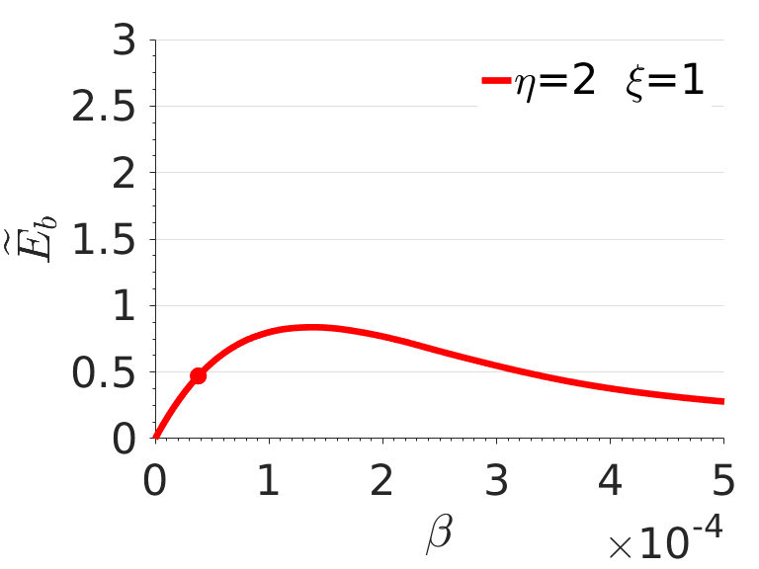
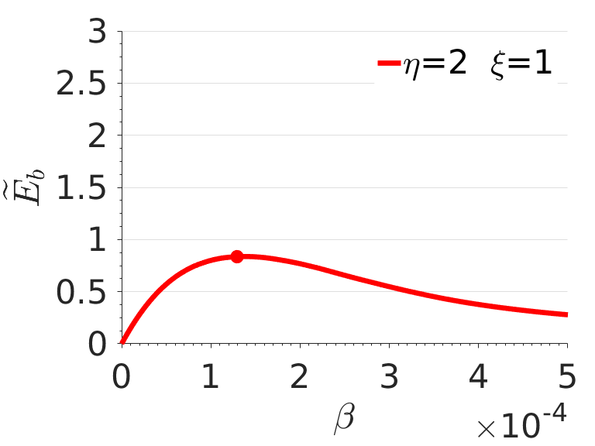
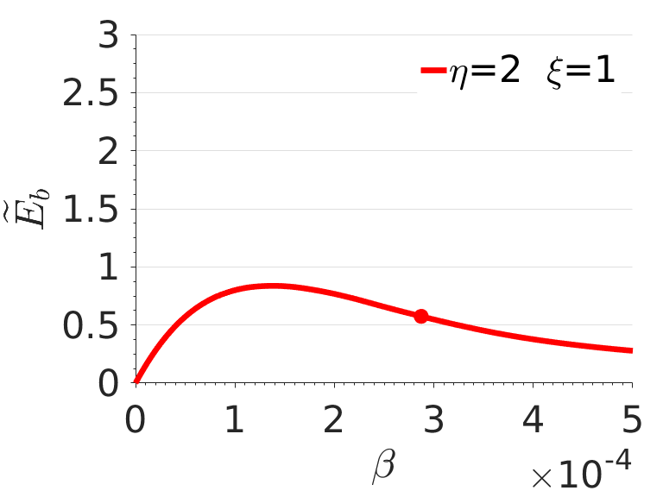






Step1: deformed shape of transfer-printed film
Notes:
14

Slide 15










Step1: deformed shape of transfer-printed film
Notes:
15

Slide 16










Step1: deformed shape of transfer-printed film
Notes:
16

Slide 17




Bending Energy: Wavelength Ratio
Notes:
17

Slide 18



Step2: Quasi-Static Spallation Model
“Rigid Spallation” : spallation process too fast for dynamic bending effect to take place
Notes:
18

Slide 19





Effective Cohesive Law Example
Notes:
19

Slide 20




SAM Real Surface Profile
DTES - Fused Silica
100nm*100nm

Slide 21


Maximum Effective Traction
Different Values of
Notes:
21

Slide 22







Slide 23








Surface Bearing Distance
Notes:
23

Slide 24

Sr Distribution
Notes:
24

Slide 25






Effect of Sr on Spallation Strength
Notes:
25

Slide 26







Correlation (and lack thereof…)
Notes:
26

Slide 27

Correlation vs. Sr(D)
Notes:
Self assembly monolayer and Interfacial fracture energy

Slide 28

Effect of SAM on Dynamic Delamination

Slide 29



Dynamic Delamination Test
a₀
L
Applied stress wave
Interfacial stress vs. kinetic energy
G_{c}$≈\frac{Ka_{0}}{a_{f}−a_{0}}$
1-D elasto-dynamic analysis
Notes:
Different from the spectral/FE method, the nonlinear beam model simulate the consequent delamination process after the spallation failure of the precrack
At that point, the precrack is lifted off the substrate at certain velocity V0 which can be determined by a simple 1D wave propagation analysis as illustrated below
In this 1D analysis, this average velocity can be determined from the total kinetic energy trapped in the pre-crack region of the film

Slide 30


Illustration: Al on Si
Tran, Kandula, Geubelle and Sottos, EFM, 2008
Kandula, Hartfield, Geubelle and Sottos, Thin Solid Films, 2008
Kandula, Tran, Geubelle and Sottos, App. Phys. Letters, 2008
Tran, Kandula, Geubelle and Sottos, IJF, 2010
Notes:
Here is an example of the deformation of the film using the beam model and for comparison, we have here also the experimental results
We got here 3 micron Al Film with 300 micron precrack which is similar to the adhesion test configuration
It clearly shows that the film experience large deformation and large rotation
The comparison with 2D model is presented in the next slide ……

Slide 31

Evolution of Kinetic Energy During Pulse Loading

Slide 32
Delaminated Gold Strip (100% MUTMS)
250 μm

Slide 33

Effect of SAM on Delamination
M₁₀₀D₀
M₇₅D₂₅
M₅₀D₅₀
M₂₅D₇₅
All scale bars: 250 μm

Slide 34

Interface Fracture Toughness

Slide 35



Conclusions
Interfacial strength of SAM-mediated interfaces strongly dependent on functional group chemistry
MD simulations point to drastic difference in strength and work of separation between methyl- and thiol- terminated SAMs
Incorporation of surface roughness critical in obtaining effective cohesive properties
Idealized surface model
Real SAM surface model
Single parameter not enough to capture roughness effect for compliant films
Experimental evidence of strong dependence of SAM functional group on interface fracture toughness
M₁₀₀D₀
M₇₅D₂₅
M₅₀D₅₀
M₂₅D₇₅

Slide 36


Wang, Liechti et al., JAM, 2006
Indentation Punch
SAM + substrate
Force
Force
Force
Force
Disp.
Disp.
Disp.
Disp.
OTS-Tungsten system

Slide 37

Figure 4. Calibration data (a) Average peak substrate stress versus fluence, and (b) Average peak interface stress versus laser fluence.

Slide 38



Slide 39

Figure 5. Optical images of film failure caused by laser induced stress wave to DTES interface(weak adhesion layer) at increasing stress amplitude. Scale bar is 500 mm

Slide 40




Max Effective Traction, Rigid Film
Notes:
40

Slide 41

Captured Variance Using Sr(D)
Notes:
Self assembly monolayer and Interfacial fracture energy

Slide 42




Recall:
Cohesive landscape ~ 0.2 nm
SAM layer thickness ~ 1 nm
Bare FS
All image scale bars have range of 1.5 nm
FS/MUTMS
Underside of Au
Scan in graph above indicated on green highlighted portion of image
Martha Grady et al.

Slide 43


Maximum Effective Traction
Change of by
Patch size
Notes:
43

Slide 44
SAMs Surface Profile: MUTMS 1

Slide 45
SAM Real Surface Profile
DTES - Fused Silica
100nm*100nm

Slide 46
SAMs Surface Profile: MUTMS 2

Slide 47
Surface Bearing Distance
Notes:
47

